Slide 1
Total including
‘mining and metals’
Excluding
‘mining and metals’
Notes:
Top 50 Australian ASX firms (by market capitalisation), excluding ETFs
As a % of GDP, nominal, financial years
Source: Morningstar
Data: Dropbox (Grattan Institute)\Productivity Growth\Reports\Competitive pressure\Data and analysis\Morningstar\Lucy\Trends data – take 2.xlsx
Sheet: “Summary”

Slide 2
Top 500
Top 200
Top 100
Top 50
Top 20
Notes:
All Australian ASX firms, excluding ETFs and mining and metals
Largest firms by revenue as % of all reported revenue, nominal, financial years
Some negative values due to write downs?
Source: Morningstar
Data: Dropbox (Grattan Institute)\Productivity Growth\Reports\Competitive pressure\Data and analysis\Morningstar\Lucy\Concentration – Australian firms only exc miners.xlsx
Sheet: “Revenue – Aust exc ETFs”

Slide 3
Notes:
Australian ASX firms, excluding ETFs and miners
ASX-wide aggregate Herfindahl index using GICS industries, financial years
Industry revenue weighted
Source: Morningstar
Data: Dropbox (Grattan Institute)\Productivity Growth\Reports\Competitive pressure\Data and analysis\Morningstar\Lucy\Concentration – Australian firms only exc miners.xlsx
Sheet: “Herfindahl weighted”

Slide 4
90th
75th
50th
25th
10th
Notes:
Largest 200 Australian ASX firms by market cap, excluding ETFs and mining and metals
Revenue weighted ROE percentiles
Source: Morningstar
Data: Dropbox (Grattan Institute)\Productivity Growth\Reports\Competitive pressure\Data and analysis\Morningstar\Lucy\ROE exc mining.xlsx
Sheet: “Weighted percentiles exc mining”

Slide 5
At or above the 90th
Between the 75th& the 90th
Between the 50th & the 75th
Between the 25th & the 50th
Between the 10th & the 25th
Below the 10th
Year after t=0
Notes:
Largest 100 Australian ASX firms by market cap at any time between 2005 and 2015, excluding ETFs and mining and metals
Decay analysis: for any ROE between 2001 and 2015, the ROE in each subsequent year up to 10 years after. ROE not adjusted for goodwill
Median ROE in t = n for each category of firms at t = 0
Source: Morningstar
Data: Dropbox (Grattan Institute)\Productivity Growth\Reports\Competitive pressure\Data and analysis\Morningstar\Lucy\Decay analysis.xlsx
Sheet: “ROE Decay (2)”

Slide 6
2011 Population, millions
Notes:
Source: World Bank, Financial Development and Structure Dataset (updated Nov. 2013)
http://econ.worldbank.org/WBSITE/EXTERNAL/EXTDEC/EXTRESEARCH/0,,contentMDK:20696167~pagePK:64214825~piPK:64214943~theSitePK:469382,00.html
3 firm bank concentration (average 2007-2011) and population (log scale)
And population: OECD.stat

Slide 7
At or above the 90th
Between the 75th& the 90th
Between the 50th & the 75th
Between the 25th & the 50th
Between the 10th & the 25th
Year after t=0
Below the 10th
Notes:
All Australian ASX firms, excluding ETFs and mining and metals, excludes negative revenue
Decay analysis: for any revenue weighted industry ROE between 2001 and 2015, the ROE in each subsequent year up to 10 years after
Median ROE in t = n for each quintile of firms at t = 0
Source: Morningstar

Slide 8
Pop’n
Australia
Largest operators
2nd
3rd
4th*
1st
Others
Notes:
Mobile operators

Slide 9
Pop’n
Australia
Largest operators
2nd
3rd
4th
1st
Others
Notes:
ISPs

Slide 10
Pop’n
Australia
Largest operators
2nd
3rd
1st
4th*
Others
Notes:
Supermarkets

Slide 11
Pop’n
Australia
Largest operators
2nd
3rd
1st
4th
Others
Notes:
Banking by deposits

Slide 12
>35%
25-35%
20-25%
15-20%
10-15%
5-10%
<5%
Notes:
Data from “Chart 3”
Revenue share by ROE
Earlier years excluded due to poorer quality data and a number of big listings

Slide 13
Western Europe and Scandinavia
PIIGS
Eastern and Central Europe
Notes:
Small business is bad for business
Employment in small business (1-19 employees) and GDP per capita ($USD ‘000s)
OECD Stat

Slide 14
Western Europe and Scandinavia
PIIGS
Eastern and Central Europe
Notes:
Big business is good business
Employment in large businesses (250+ employees) and GDP per capita ($USD ‘000s)
OECD Stat

Slide 15
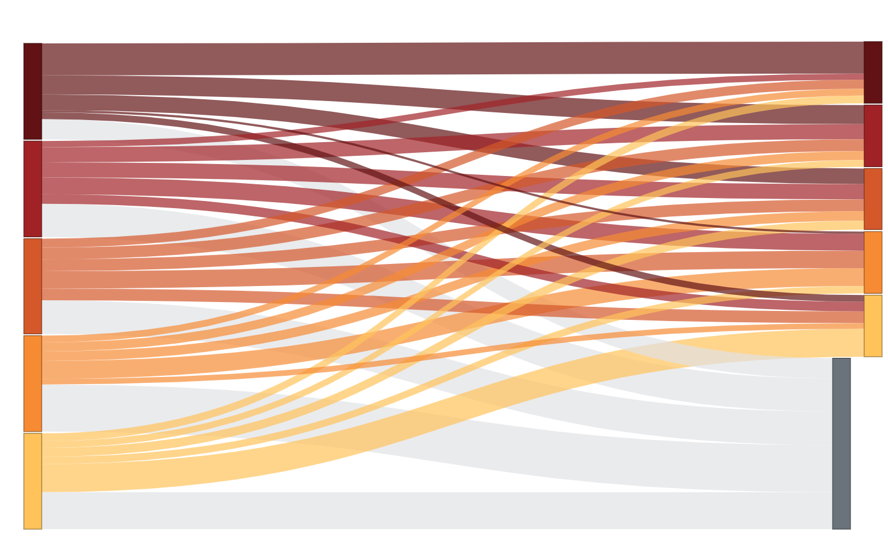
5th
5th
4th
4th
3rd
2nd
3rd
1st
2nd
No data*
1st

Slide 16
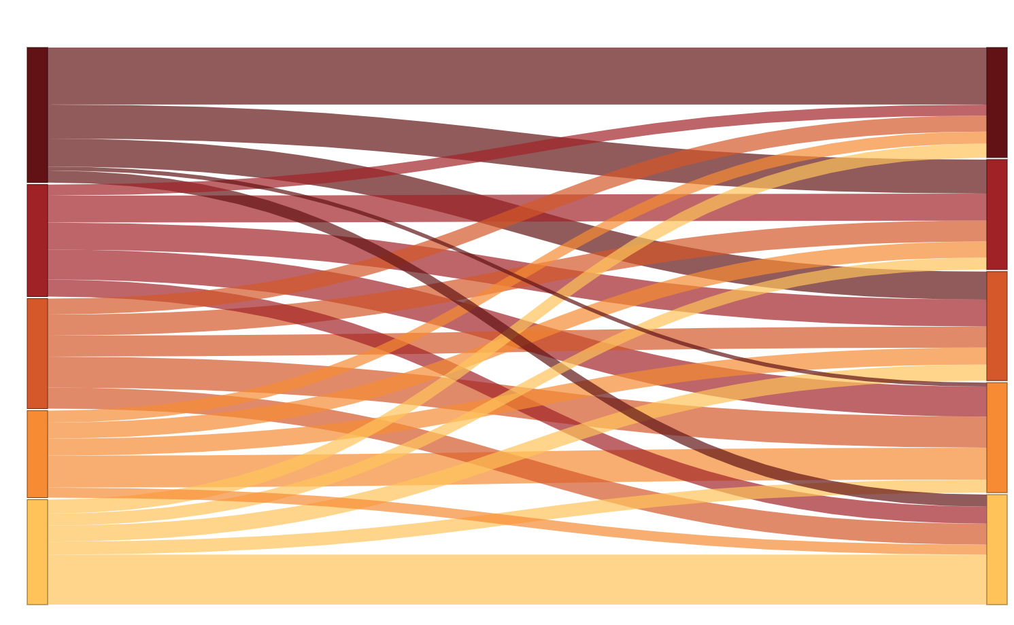
5th
5th
4th
4th
3rd
3rd
2nd
2nd
1st
1st

Slide 18
Australia
2nd
3rd
4th
Largest operators
5th
1st
Others
Notes:
Health insurance

Slide 19
Value added
2nd
3rd
4th
Largest operators
1st
5th
Others
Notes:
Barrier: Natural monopoly

Slide 20
Value added
2nd
3rd
4th
Largest operators
1st
5th
Others
Notes:
Barrier: Network effects

Slide 21
Value added
2nd
3rd
4th
Largest operators
1st
5th
Others
Notes:
Barrier: Reg

Slide 22
Value added
2nd
3rd
4th
Largest operators
1st
5th
Others
Notes:
Barrier: NONE

Slide 23
Domestic private sector
Low barriers
Natural monopoly
Network effects
Higher regulation
Public
Tradable
Total

